Slide 1
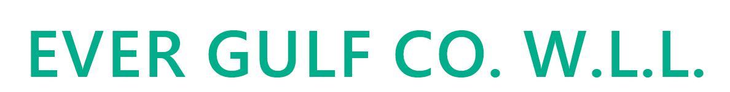
Strategy Management Platform
Dashboards Recommendation
LEADING INNOVATION IN DIGITAL SOLUTIONS

Slide 2
Overview
The purpose of this presentation is to highlight a number of main dashboards and reports along with related attributes and filters. At this phase it will be mainly a mockup or a dashboard suggestion, once discussed and agreed upon, the dashboards will be designed and provided for approval, some of the recommended dashboards are:
Management Dashboards
Strategic Overview Dashboard
Objectives and related KPIs (Internal process vs Enablers)
Projects Progress
Projects Closure
Risk Management Dashboard
Department Dashboards
Project Performance Dashboard
Lessons Learned
Issue Tracking Dashboard
Departmental Risk Dashboard
Project Progress
Strategy Map
Programs
Projects
Project Risk
Projects
Strategy Theme
KPI Change Request
Project Issues
Projects
KPIs
Project
CR
Strategy Objectives
Projects
Project
Events

Slide 3
Dashboard Drill Down Map
Project Progress
Strategy Map
Programs
Projects
Project Risk
Projects
Strategy Theme
KPI Change Request
Project Issues
Projects
KPIs
Project
CR
Strategy Objectives
Projects
Project
Events

Slide 4
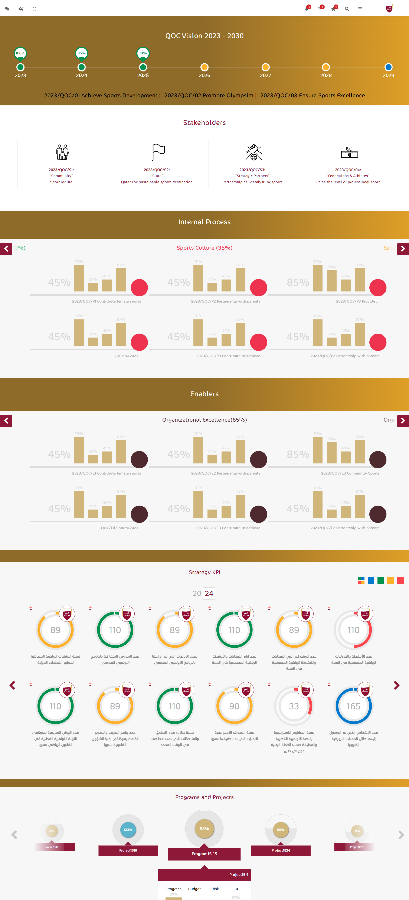
Strategic Overview Dashboard Management Dashboards
Attributes:
The percentage of the progress of achieving the Strategic Themes
Internal process \ Enablers
KPI Overview: Display of all KPIs, their targets, actuals, variance, and status (on track, at risk, off track).
Organization performance Overview.
Filters:
Time Period (Quarterly, Yearly)
Internal process \ Enablers
KPI Status (on track, at risk, off track)
Project Status (Active, Completed, On-Hold)
Recommended Dashboards
Boxes Summary
Donut Charts
Progress Charts
Export and Drill down:
Each drill down button takes to the Strategy Overview Dashboard.
Export Excel and PDF.

Slide 5
Strategic Overview Dashboard Management Dashboards
Attributes:
Strategic Objectives: List of strategic objectives, their current progress, and completion percentage.
KPI Overview: Display of all KPIs, their targets, actuals, variance, and status (on track, at risk, off track).
Objectives (internal process and Enablers with overall completion percentage)
Project Alignment: Percentage of projects aligned with strategic objectives, their impact on strategic objectives.
Filters:
Time Period (Quarterly, Yearly)
Strategic Objective
KPI Status (on track, at risk, off track)
Project Status (Active, Completed, On-Hold)
Recommended Dashboards
Boxes Summary (similar to the ones in this page)
Bar chart
Pie charts
Export and Drill down:
Drill down Action: on click on an Objective, it opens up all objectives under it, on click on any of these objectives it opens the related KPIs with status, on KPI click it opens up projects and status.
Export Excel and PDF.

Slide 6
Objectives and related KPIs Management Dashboards
Attributes:
Objectives (internal process and Enablers with overall completion percentage)
Internal Process: List of internal processes, their current progress, and completion percentage.
Enablers: List of Enablers, their current progress, and completion percentage.
Project Alignment: Percentage of projects aligned with Above selected options (Internal process or Enablers).
Filters:
Time Period (Quarterly, Yearly)
Theme (filter by theme)
Type (Internal process, Enablers)
Department (select department)
Project Progress (based on selected type or filter)
Recommended Dashboards
Split screen a side for each type (internal process \ enablers)
Gauge Chart
Bar chart
Donut chart
Export and Drill down:
Each drill down button takes to the list of items, example “Internal Process” drills down to all internal processes
Drill down Action: on click on an Objective, it opens up all objectives under it, on click on any of these objectives it opens the related KPIs with status, on KPI click it opens up projects and status.
Export Excel and PDF.

Slide 7
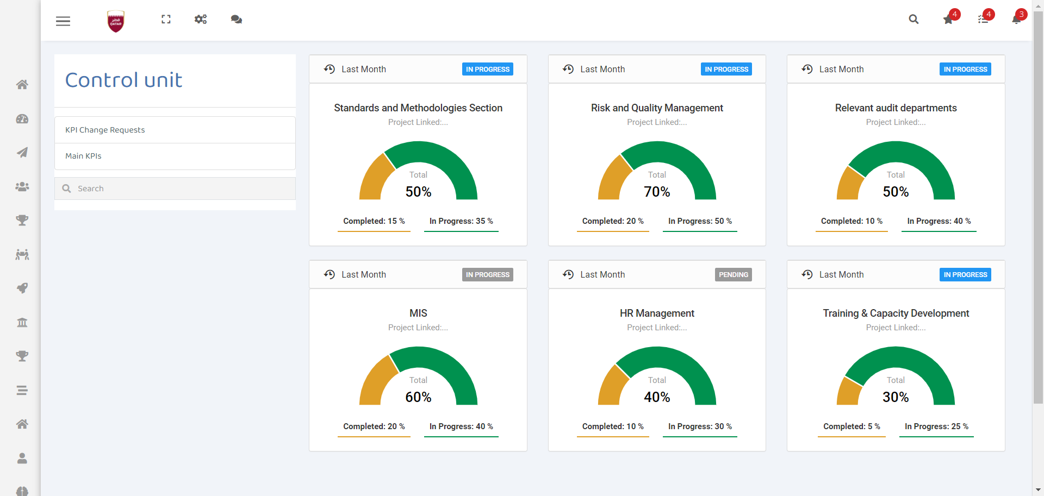
Objectives and related KPIs – Drill down Management Dashboards

Slide 8
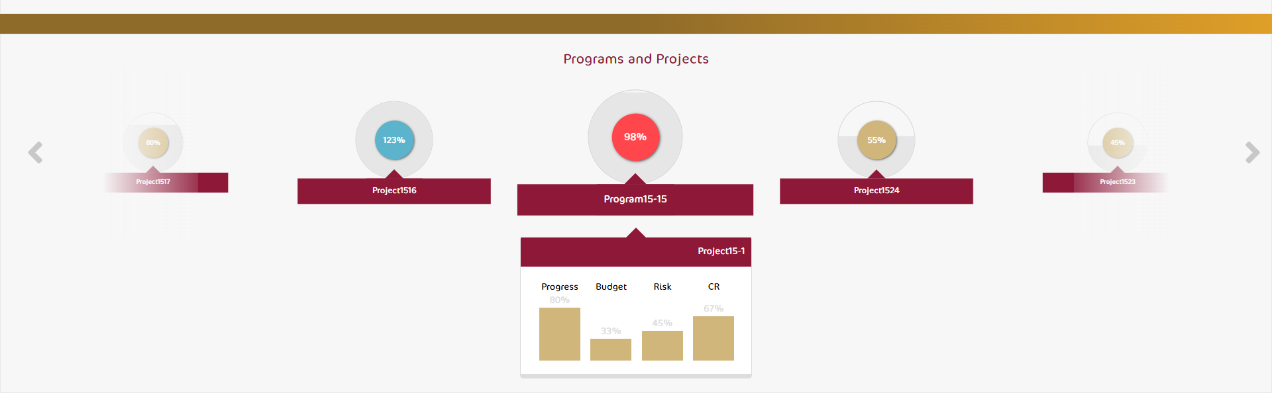
Projects Progress Management Dashboards
Attributes:
Project Overview: List of projects with key details like start date, end date, budget, and completion percentage.
Task Completion: Upcoming and completed tasks, percentage completion, and delays.
Resource Allocation: Breakdown of resources allocated by project.
KPI Targets vs. Actuals: KPI performance for each project, variance analysis, and corrective actions.
Filters:
Department/Team
Project Status (Active, Completed, On-Hold)
Project Type (Event, Project…)
Time Period (Monthly, Quarterly…)
Recommended Dashboards
Top or Priority Projects as high level Progress Doughnut chart
Table or Grid View
Pie Chart
Export and Drill down:
Each drill down button takes to the list of items, example “Project X” drills down to project details
Drill down Action: on click on a project, it provides project progress details, tasks, and milestones, along with duration and related dates.
Export Excel and PDF.

Slide 9
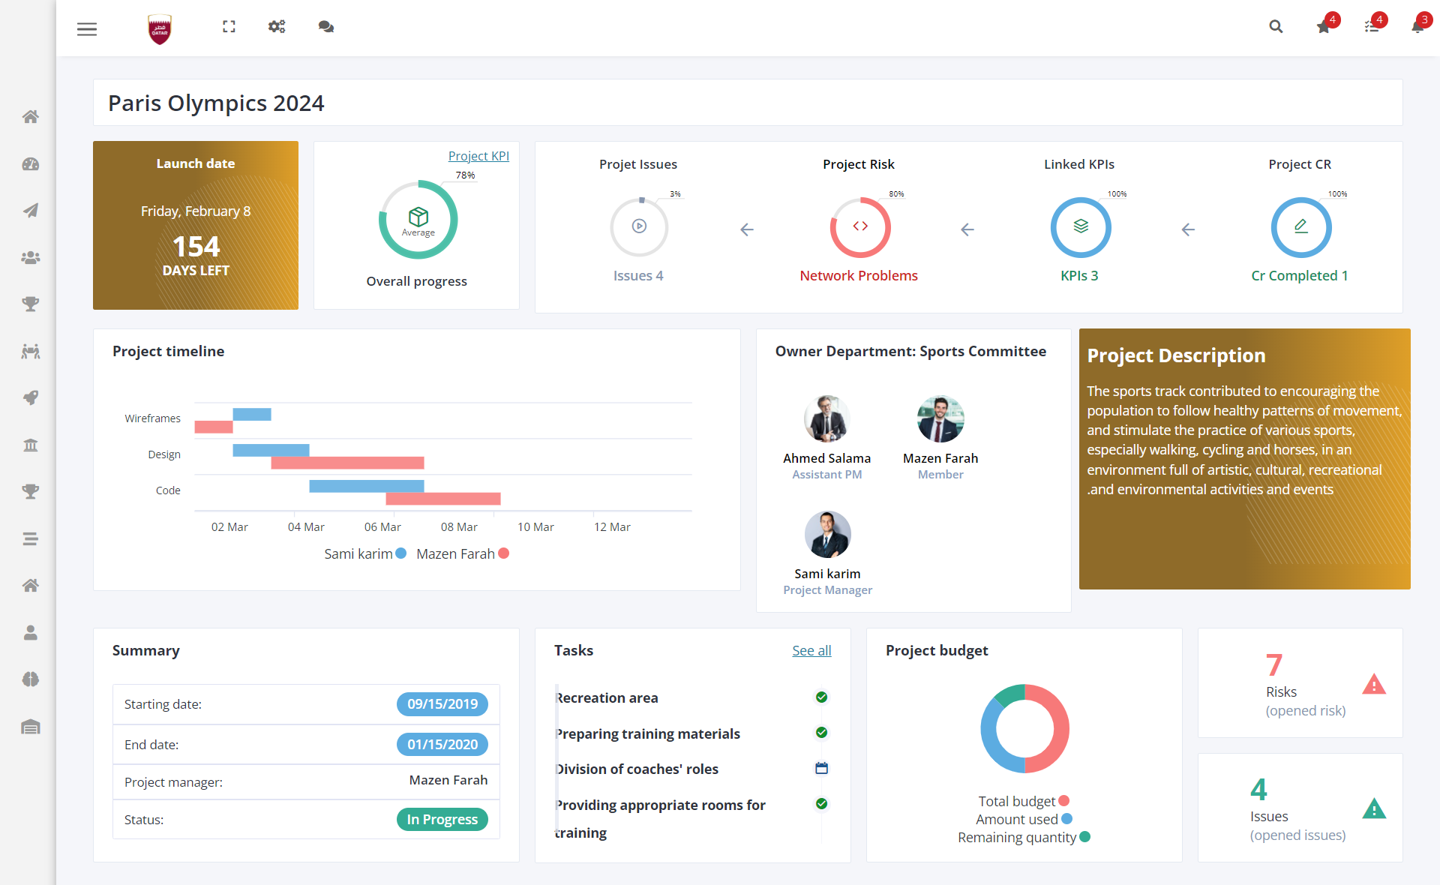
Projects Progress Management Dashboards

Slide 10
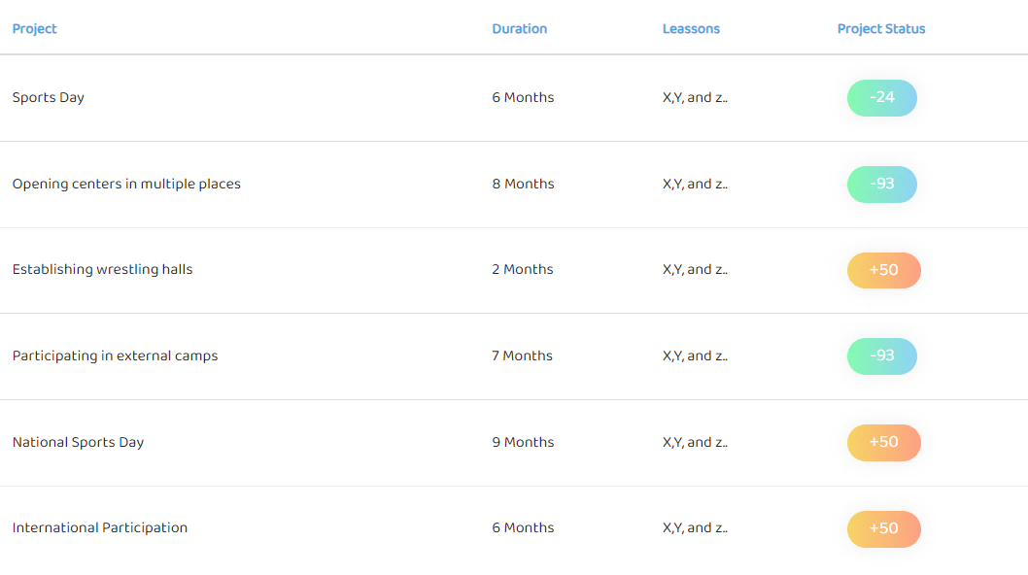
Projects Closure Management Dashboards
Attributes:
Project Name
Duration
Lessons Learned
Details
Filters:
Time Period (Monthly, Quarterly, Yearly)
Type (Project type)
Department (select department)
Duration
Recommended Dashboards
Table or Grid View
Export and Drill down:
Each drill down button takes to the list of items, example “Lesson Learned” drills down to all Lessons learned
Export Excel and PDF.

Slide 11
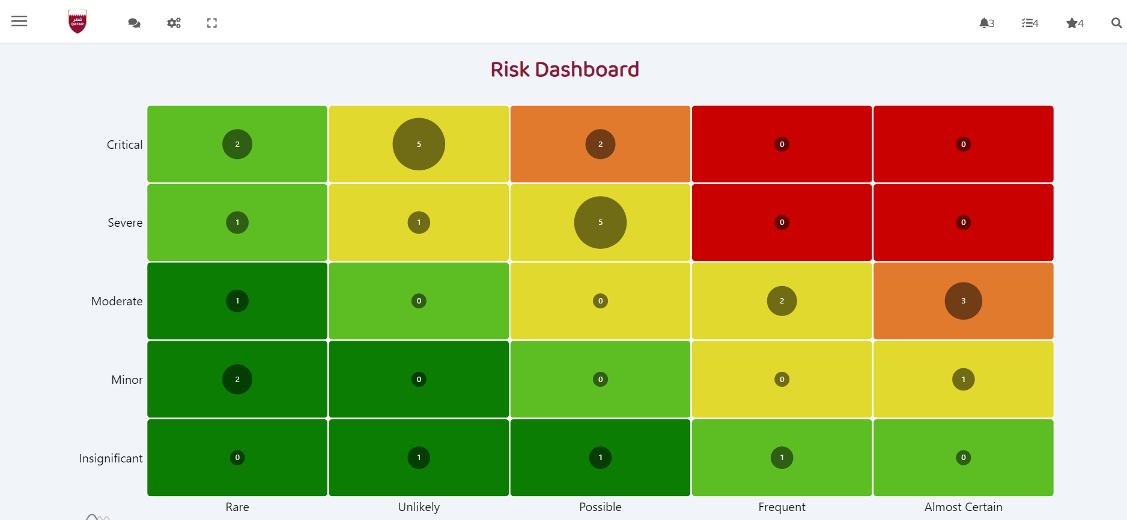
Risk Dashboard Management Dashboards
Attributes:
Risk Register: List of identified risks, their severity (Low, Medium, High).
Issue Tracker: Open issues with their priority, resolution status, and department responsible.
Risk Trends: List of opened risks per month.
Filters:
Risk Severity
Project/Department
Risk Type (project, strategic)
Issue Status (Open, In Progress, Resolved)
Recommended Dashboards
Boxes Summary + overall circular percentage status
Combo Chart
Heatmap Chart
Export and Drill down:
Each drill down button takes to the list of items, example “Risk Register” drills down to all related risks
Export Excel and PDF.

Slide 12
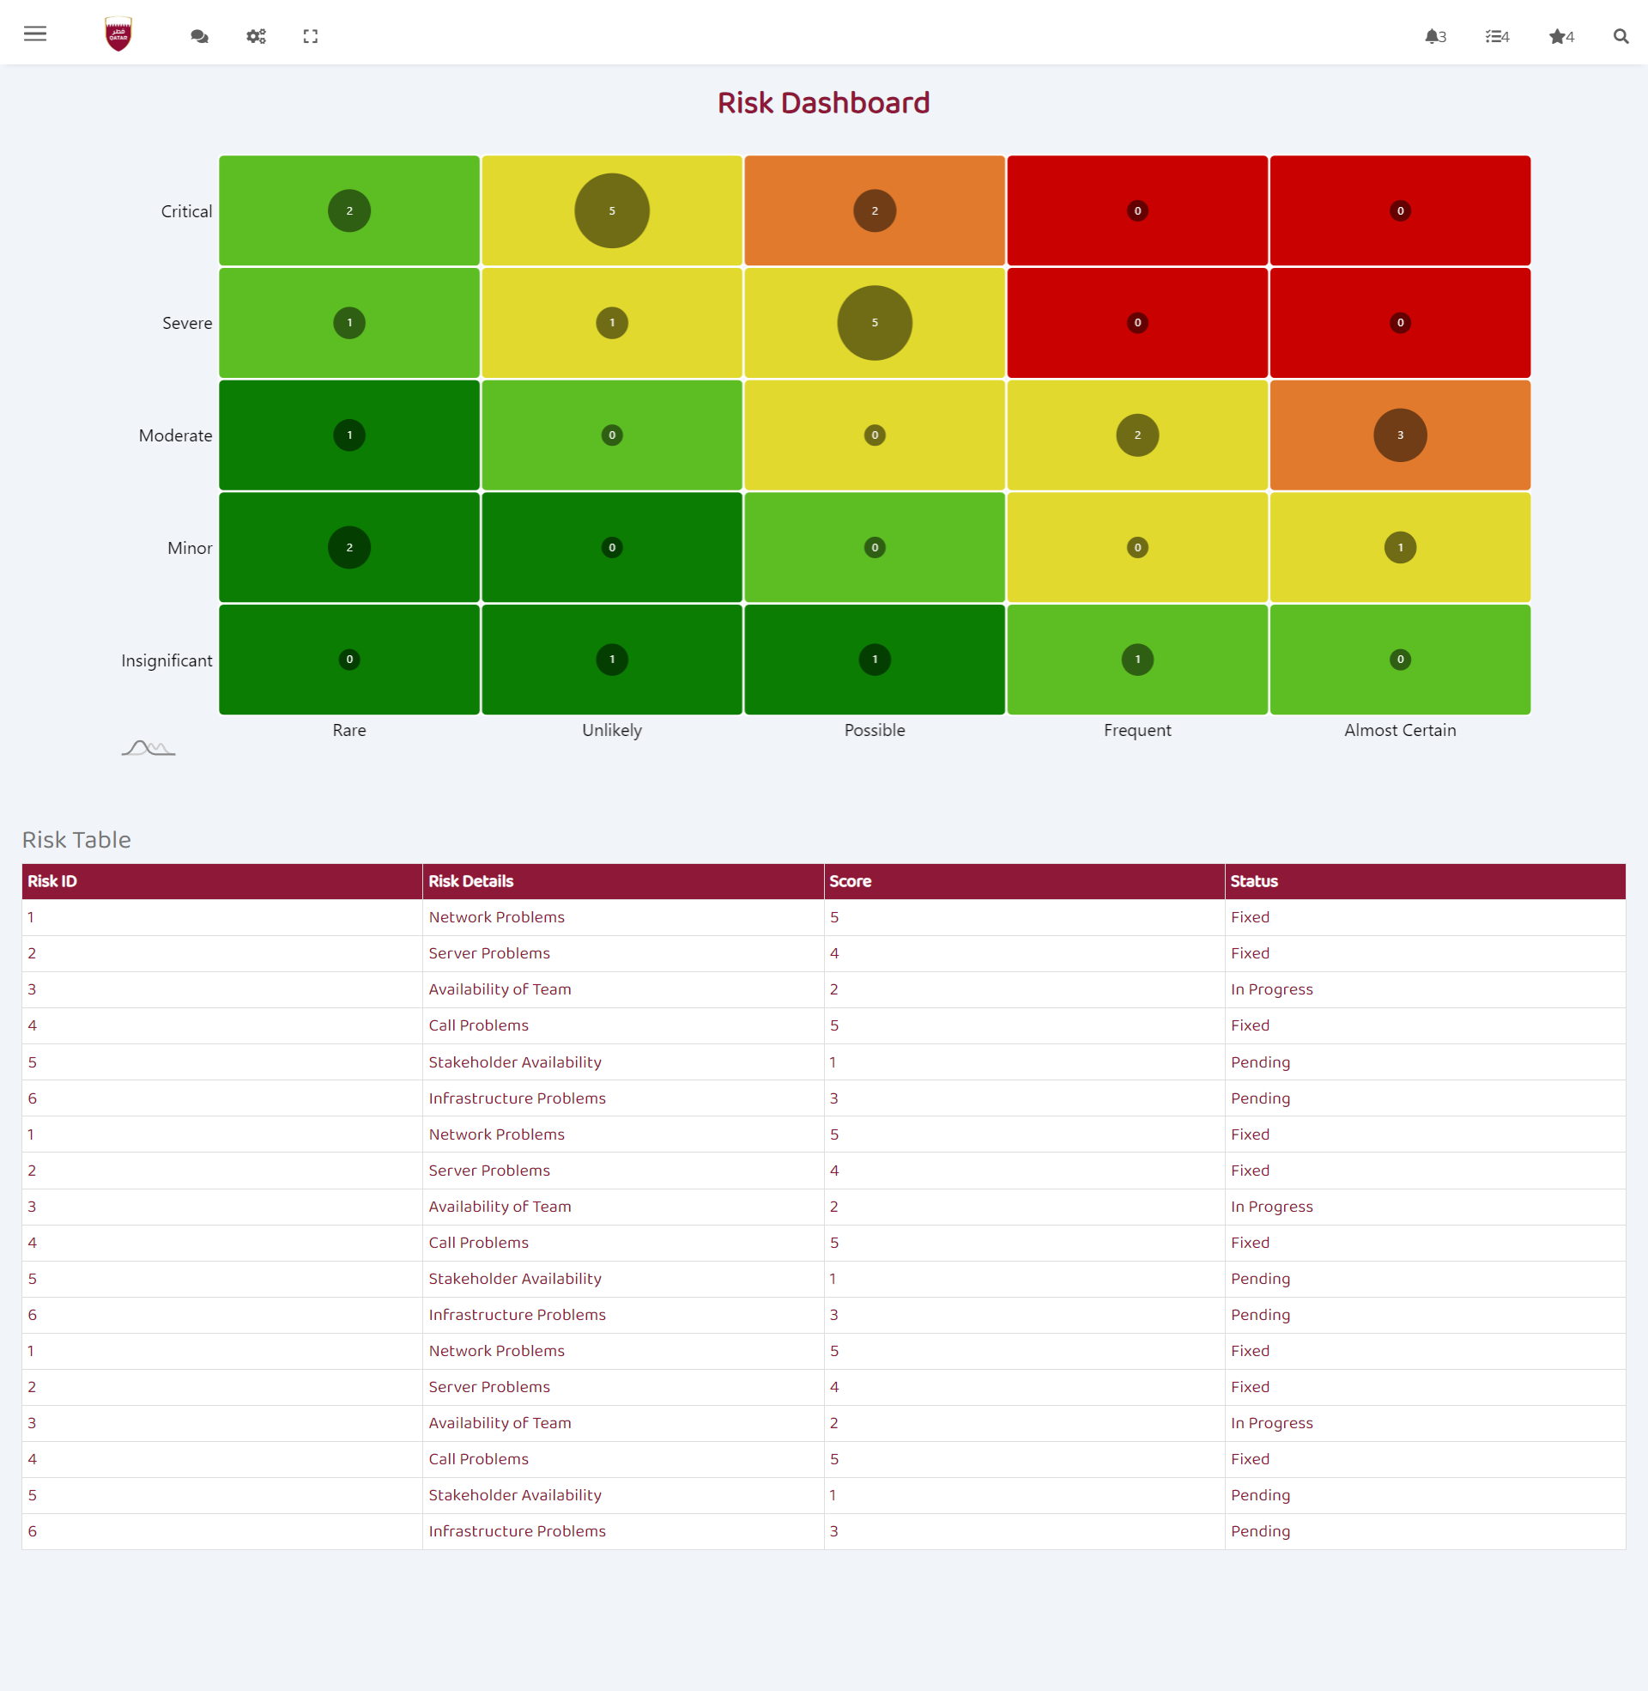
Risk Dashboard – Drill Down Management Dashboards

Slide 13
Department Dashboards
Mainly similar in view of the management dashboards but filtered by department according to the logged user’s role and their permissions.
Project Performance Dashboard and Lessons Learned
Issue Tracking Dashboard
Departmental Risk Dashboard
Department KPI Dashboard

Slide 14







WE LOOK FORWARD TO TRANSFORMING
YOUR DATA INTO KNOWLEDGE
THANK YOU
@ Intalio
@ Intalio
@Intalio
@Intalio
@Intalio
www.intalio.com

